Slide 1
Nomad Program Overview

Slide 2
Overview
Nomad Overview
Wanderer Description
Nomad Program Overview
Nomad Specific Modifications

Slide 3
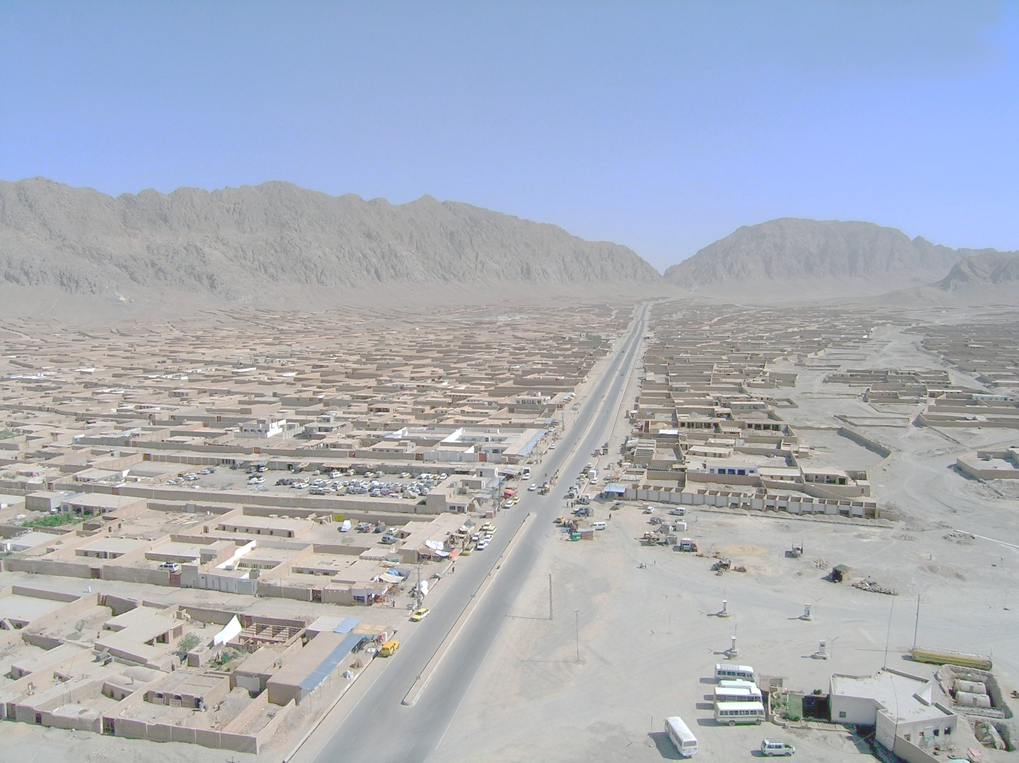
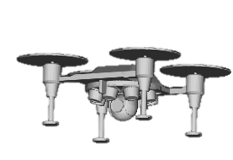
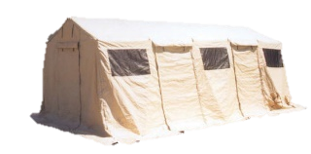
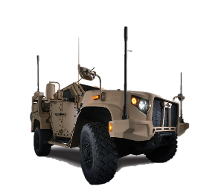
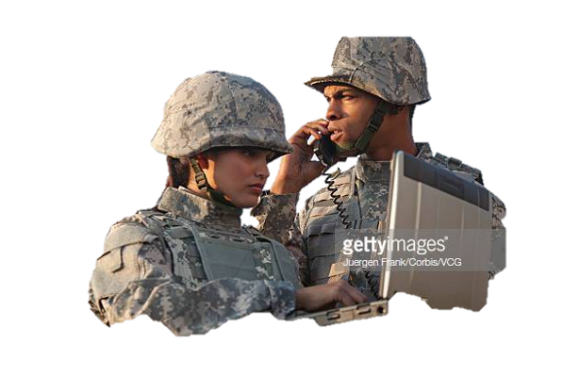
Nomad Overview
Capable Sensors
Day / Night HD video
400,000 sq ft persistent coverage
Built from wildly successful Wanderer heavy-lift quadcopter
Over 800 currently operating in US airspace
FAA 14 CFR part 107 Compliant
Tailored for OTSS-E requirements
Non-Import vehicle computers
High performance sensors
GPS Jam resistant
Rapidly deployable ground station
Military communications
Proven Vehicle
Built on successful commercial system
Long endurance – 35 minute missions
High performance
Mobile GCS
Easily transported
Full vehicle control
Connected to combat networks

Slide 4
History
10 Jul 19: OTSS-E Phase 1 Award
Jul - Dec 19: Nomad Development
Jul 19: Legacy system analysis/re-testing
Aug 19: Flight Performance Expansion
Sep 19: Initial Payload Testing
Nov 19: Final Payload Testing
Nov 19: Deployment Testing

Slide 5
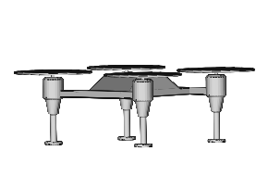
Wanderer Overview
High Performance – Heavy Lift Utility Quadcopter
Extremely Capable
Heavy payloads – up to 80 lbs
Long endurance – as long a 2 hours
High altitude – greater than 1200 ft AGL
High speed – 50 mph capable
*depending on configured options
Versatile Payloads
Offered with multiple payloads
Or configurable by user
Modular mounting plate for payload attachment
Flexible ground station options
Proven Operations
Over 800 currently operating in US airspace – film, gas pipelines, aerial survey, security operations
FAA 14 CFR part 107 Compliant
Robust long range control link
Highly reliable > 600 flight hour life

Slide 6
Wanderer Variants
Mark 1 – Video Photography
Configured with multiple camera configurations, including 4k filming rig, ultra zoom photography, thermal survey cameras
Short range, high bandwidth optical payload datalink
Mark 2 – Aerial Survey
Multiple wide angle cameras to capture large swathes of land
Intended for semi-autonomous operation
Mark 3 – Remote access point
Long range line of sight comms to air vehicle
Wifi networking to remote points beneath vehicle

Slide 7
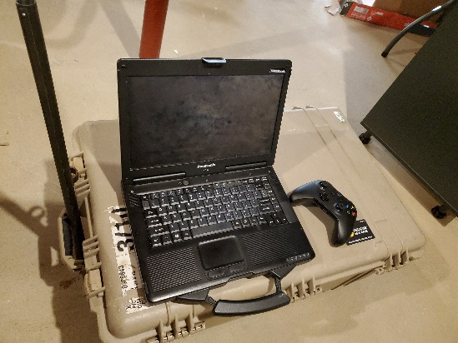
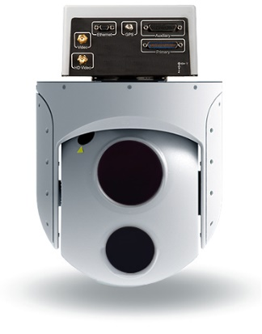
Nomad Capabilities
Nomad Payloads
Leverages Wanderer baseline
Primary structure
Motors
Electrical system
Control Link
Demonstrated to meet OTSS-E performance requirements!
System | Model | Performance
Full Motion Video | CloudCap TASE 415HD | HD EO and MWIR Imagery
Wide Area Camera | XYZ Bluefire Camera System | 0.50m GSD EO/IR imagery
Payload Datalink | Z4 Technologies Multi-band Datalink | 35mb/s AES256 encrypted link
GPS | Puck Solutions PS450 Jam Resistant GPS | GPS with improved functionality in GPS degraded env
Mobile GCS
Combined transit case / base station
Lightweight (<30 lbs)
Multiple power options – battery, shore, vehicle
Extremely rugged

Slide 8
Wanderer Modifications
Needed updates to sensors to meet new performance requirements
New, larger imaging sensor/optics – new lenses
Required mounting more forward than wanderer to provide unobstructed FOV
Improved communications range / encryption
Legacy flight controller was made in China
New security requirements required the development of a new FCS
Demonstrated to be functionally equivalent to legacy variant
Successfully tested using legacy system configurations

